Slide 1
DC Circuits
Thevenin's Theorem Examples
By Dr. Ahmed S. Abdullah
د. احمد سليمان عبدالله

Slide 2
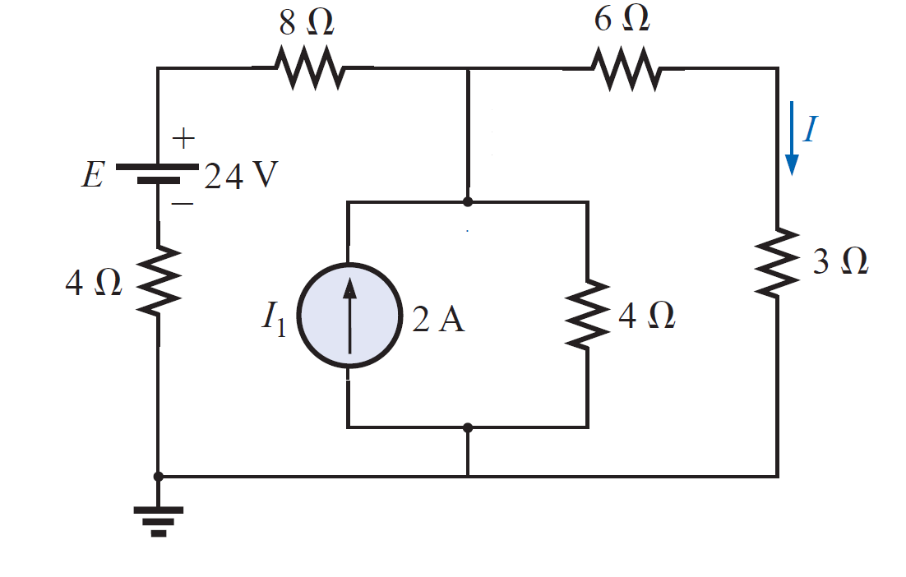
Thevenin's Theorem
EXAMPLE 1: Use the Thevenin theorem to find the current through 3Ω for the circuit of figure shown.

Slide 3
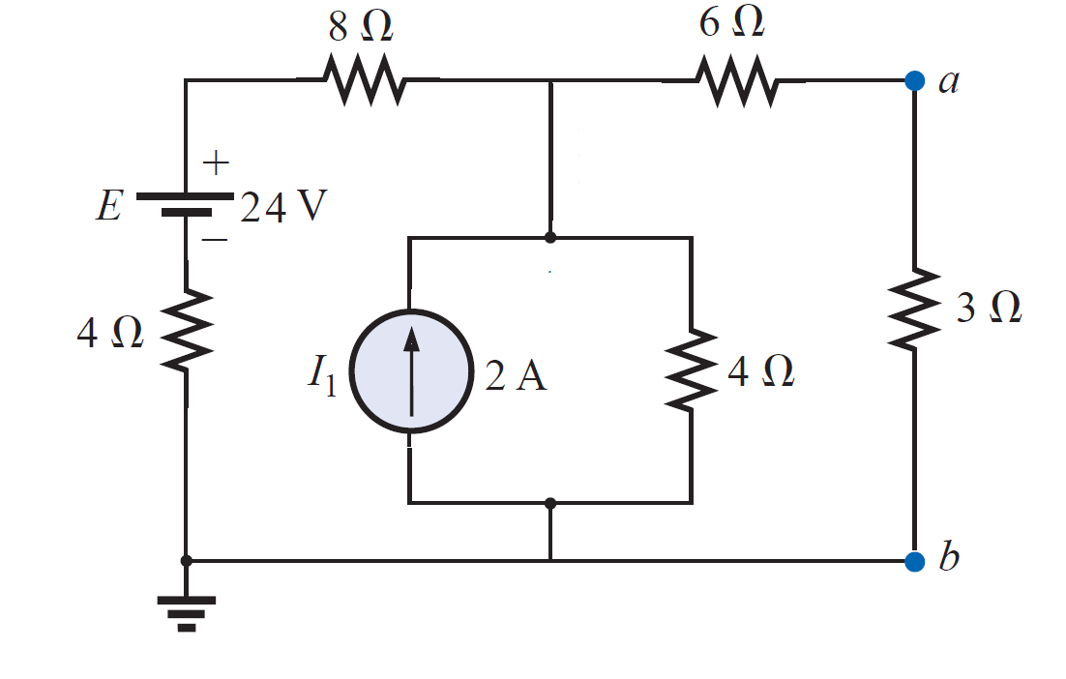
Thevenin's Theorem
EXAMPLE 1: Use the Thevenin theorem to find the current through 3Ω for the circuit of figure shown.
Solution:-
Step 1 and 2:-

Slide 4
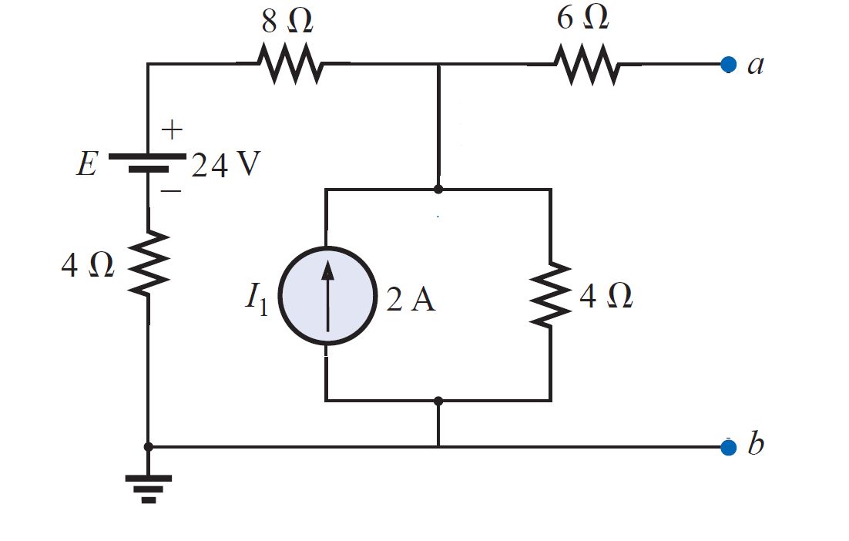
Thevenin's Theorem
EXAMPLE 1: Use the Thevenin theorem to find the current through 3Ω for the circuit of figure shown.
Solution:-
Step 1 and 2:-

Slide 5
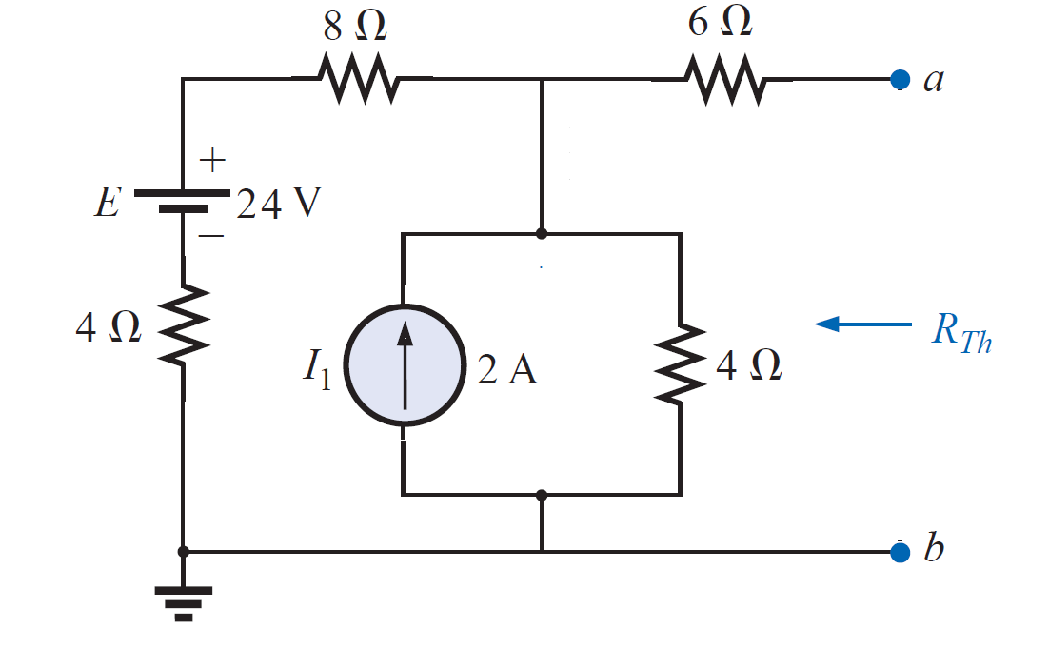
Thevenin's Theorem
EXAMPLE 1: Use the Thevenin theorem to find the current through 3Ω for the circuit of figure shown.
Solution:-
Step 3:-

Slide 6
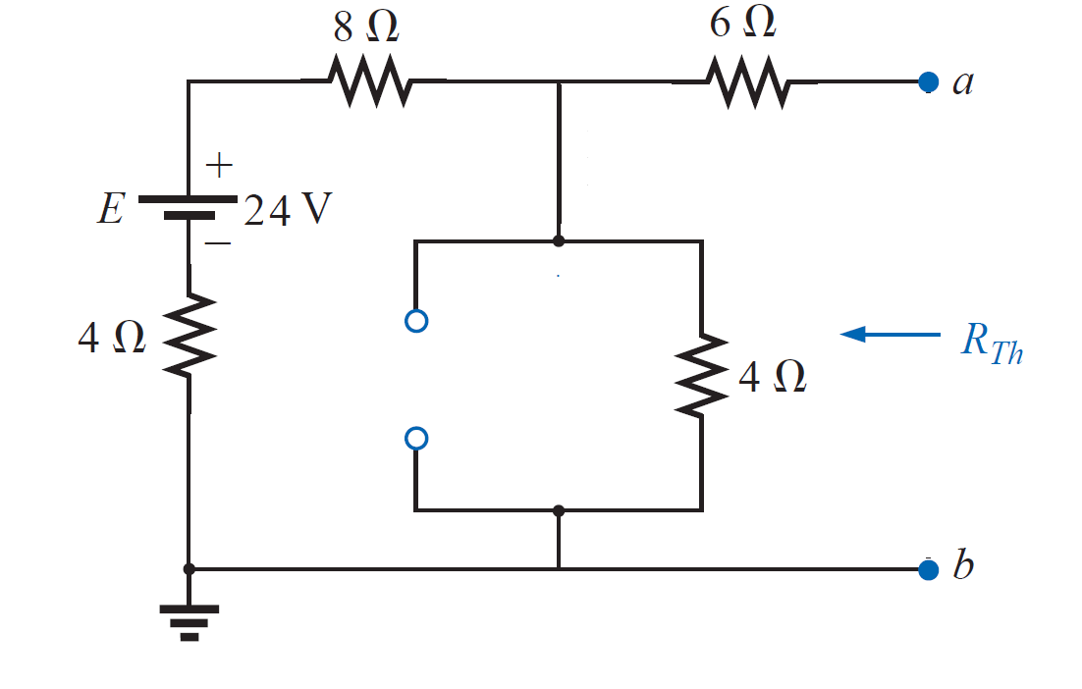
Thevenin's Theorem
EXAMPLE 1: Use the Thevenin theorem to find the current through 3Ω for the circuit of figure shown.
Solution:-
Step 3:-

Slide 7
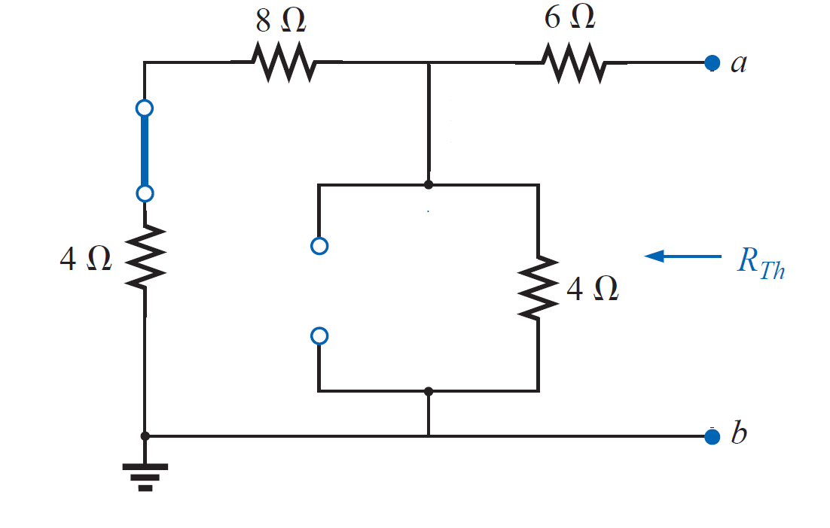
Thevenin's Theorem
EXAMPLE 1: Use the Thevenin theorem to find the current through 3Ω for the circuit of figure shown.
Solution:-
Step 3:-

Slide 8
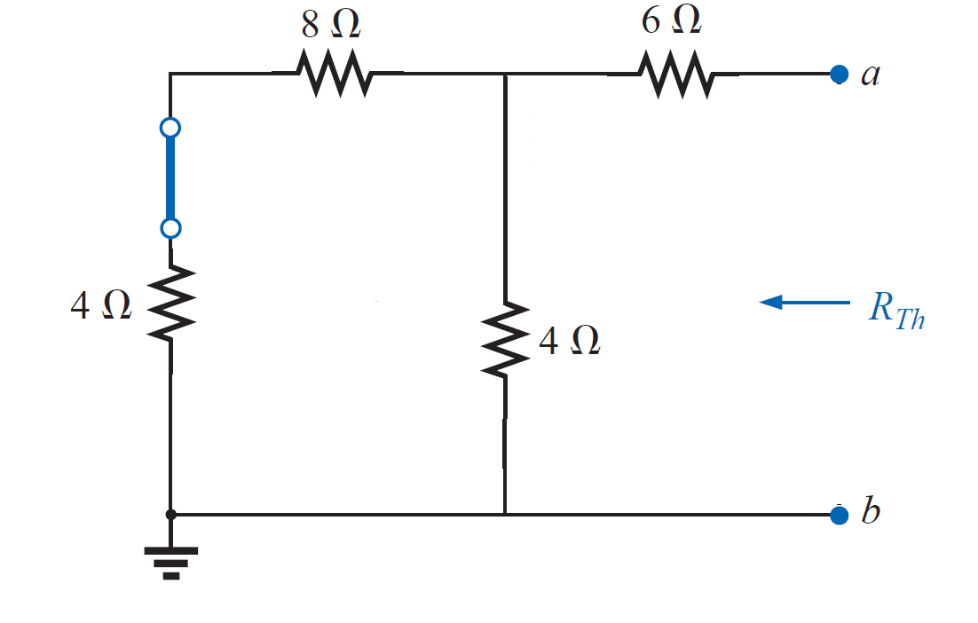
Thevenin's Theorem
EXAMPLE 1: Use the Thevenin theorem to find the current through 3Ω for the circuit of figure shown.
Solution:-
Step 3:-

Slide 9
Thevenin's Theorem
EXAMPLE 1: Use the Thevenin theorem to find the current through 3Ω for the circuit of figure shown.
Solution:-
Step 3:-
$R_{Th}=6Ω+(4Ω/$/ 12 $Ω$ )
$=6Ω+3Ω$ = 9 $Ω$

Slide 10
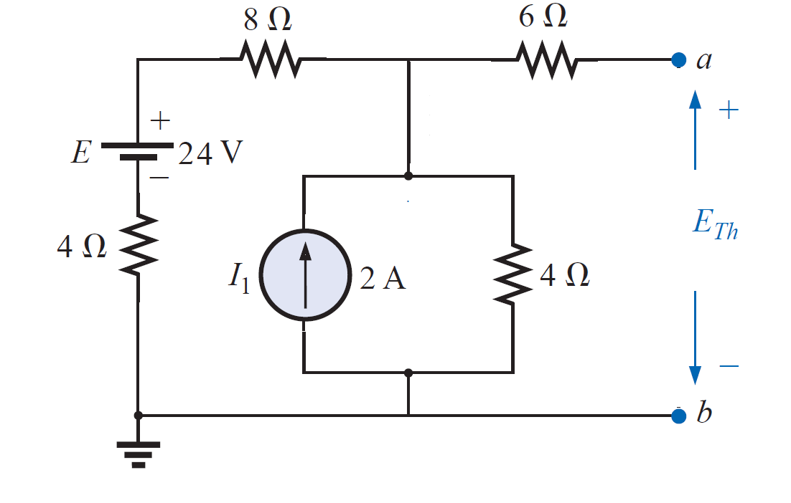
Thevenin's Theorem
EXAMPLE 1: Use the Thevenin theorem to find the current through 3Ω for the circuit of figure shown.
Solution:-
Step 4:-
$$E=2A ×4Ω=8 V$$

Slide 11
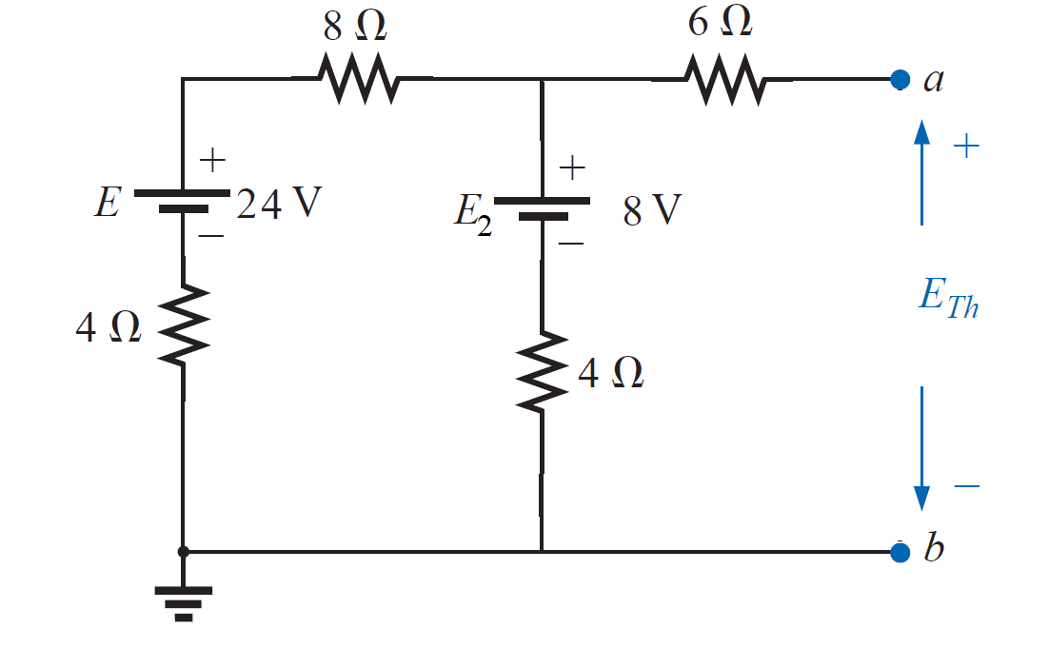
Thevenin's Theorem
EXAMPLE 1: Use the Thevenin theorem to find the current through 3Ω for the circuit of figure shown.
Solution:-
Step 4:-
$$E=2A ×4Ω=8 V$$

Slide 12
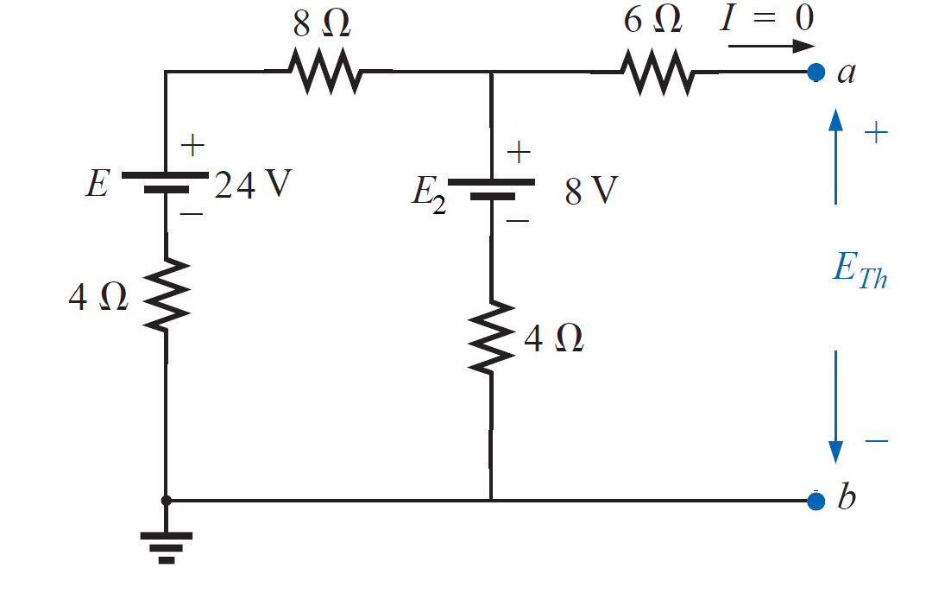
Thevenin's Theorem
EXAMPLE 1: Use the Thevenin theorem to find the current through 3Ω for the circuit of figure shown.
Solution:-
Step 4:-

Slide 13
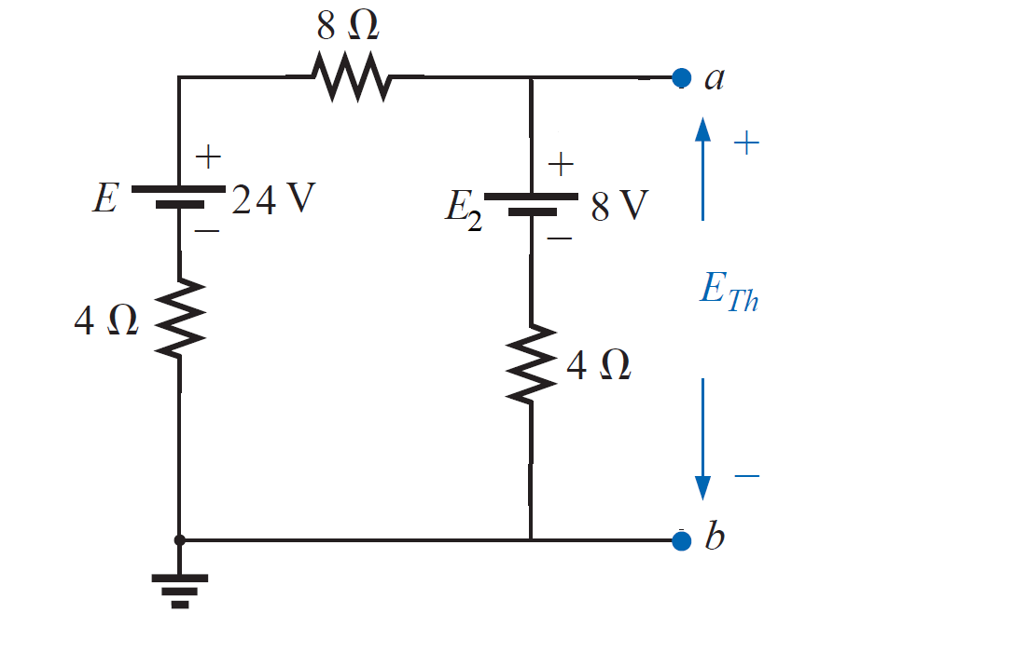
Thevenin's Theorem
EXAMPLE 1: Use the Thevenin theorem to find the current through 3Ω for the circuit of figure shown.
Solution:-
Step 4:-
$$E_{Th}=8 V+V_{4Ω}$$

Slide 14
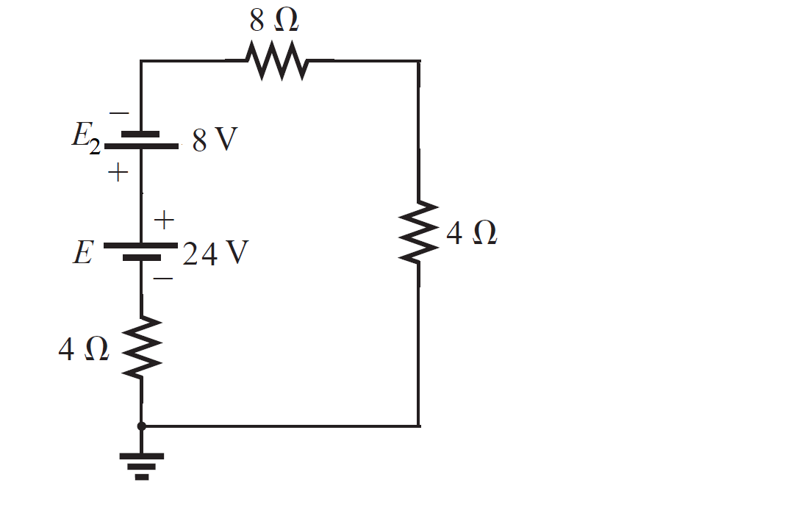
Thevenin's Theorem
EXAMPLE 1: Use the Thevenin theorem to find the current through 3Ω for the circuit of figure shown.
Solution:-
Step 4:-

Slide 15
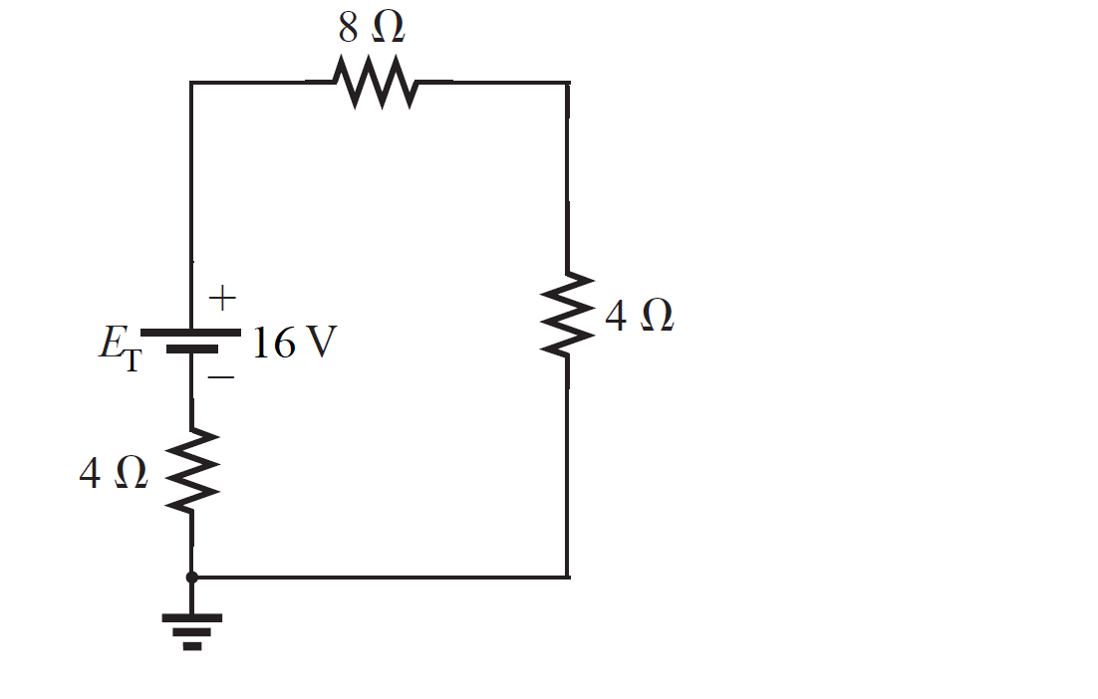
Thevenin's Theorem
EXAMPLE 1: Use the Thevenin theorem to find the current through 3Ω for the circuit of figure shown.
Solution:-
Step 4:-
$$E_{T}=E − E_{2}$$
$=24 V −8 V=16 V$

Slide 16
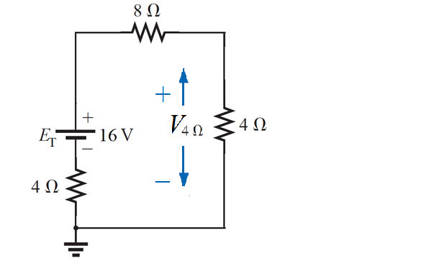
Thevenin's Theorem
EXAMPLE 1: Use the Thevenin theorem to find the current through 3Ω for the circuit of figure shown.
Solution:-
Step 4:-
Applying the voltage divider rule,
$$V_{4Ω}= \frac{E_{T}×4Ω}{4Ω+8Ω+4Ω}=\frac{16V×4Ω}{16Ω}=\frac{64}{16}=4 V$$

Slide 17
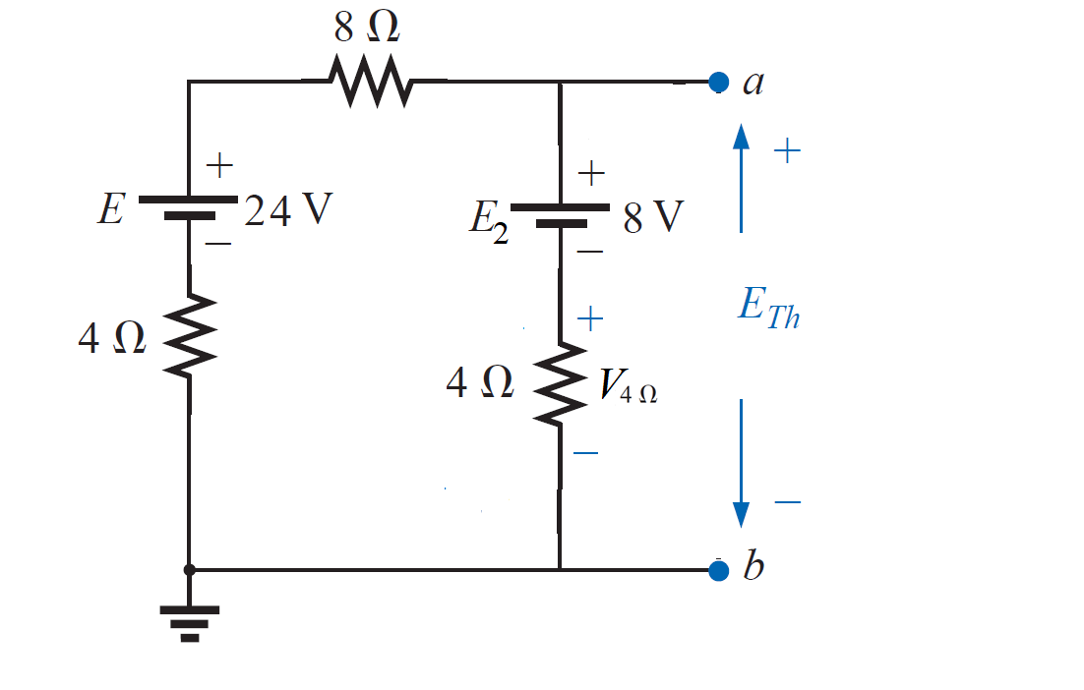
Thevenin's Theorem
EXAMPLE 1: Use the Thevenin theorem to find the current through 3Ω for the circuit of figure shown.
Solution:-
Step 4:-
$$E_{Th}=8 V+V_{4Ω}$$
$=8 V+4 V=12 V$

Slide 18
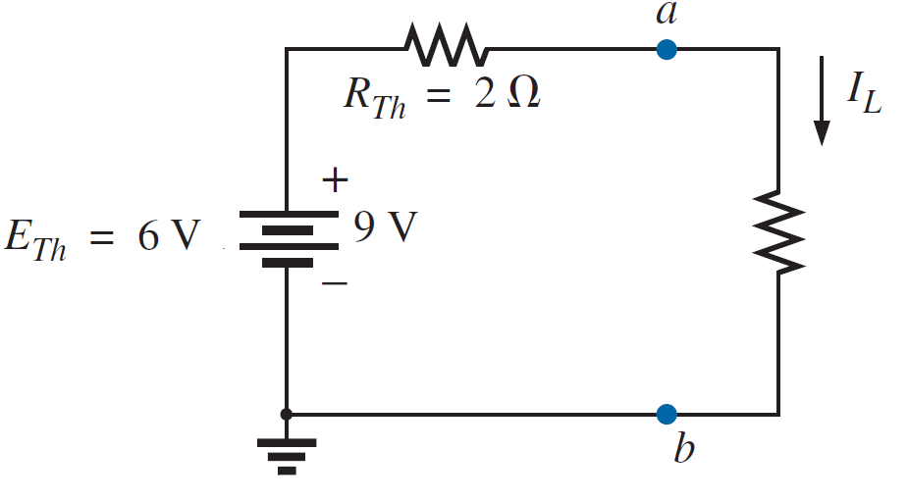
Thevenin's Theorem
EXAMPLE 1: Use the Thevenin theorem to find the current through 3Ω for the circuit of figure shown.
Solution:-
Step 5:-
$$R_{Th}=9Ω$$
$$I_{L}=\frac{E_{Th}}{R_{Th}+R_{L}}$$
$$E_{Th}=12V$$
$$R_{L}=3Ω$$
$$I_{L}=\frac{12 V}{9Ω+3Ω}= \frac{12}{12}=1 A$$

Slide 19
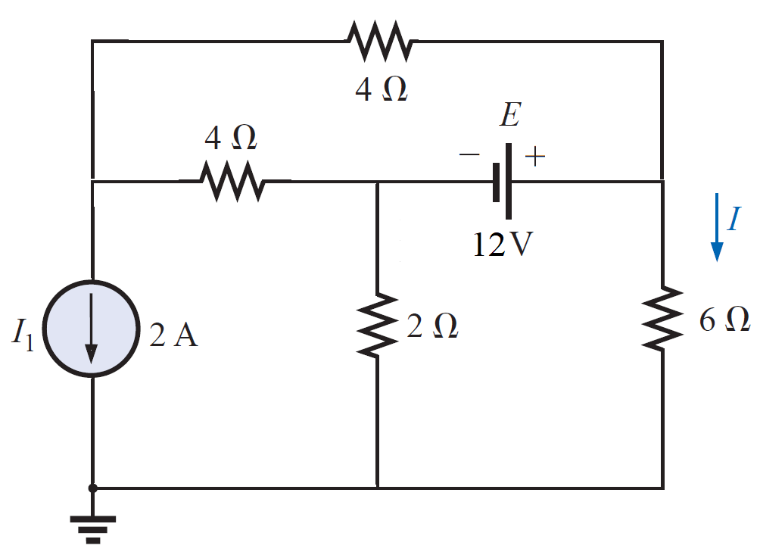
Thevenin's Theorem
EXAMPLE 2: Use the Thevenin theorem to find the current through 6 Ω for the circuit of figure shown.

Slide 20
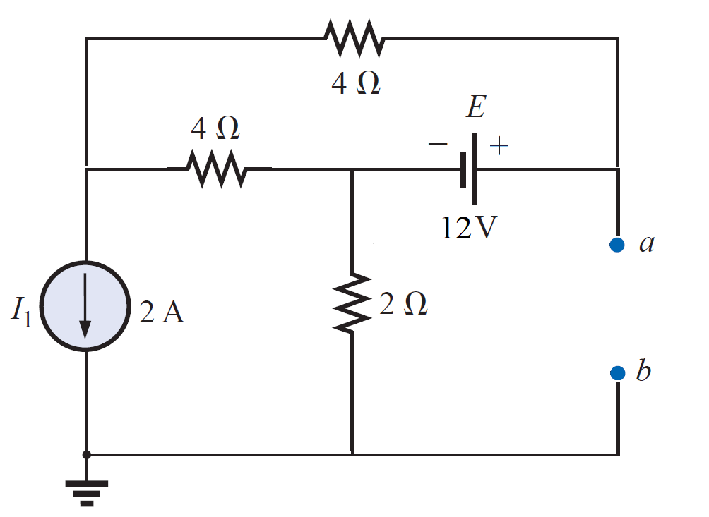
Thevenin's Theorem
EXAMPLE 2: Use the Thevenin theorem to find the current through 6 Ω for the circuit of figure shown.
Solution:-
Step 1 and 2:-

Slide 21
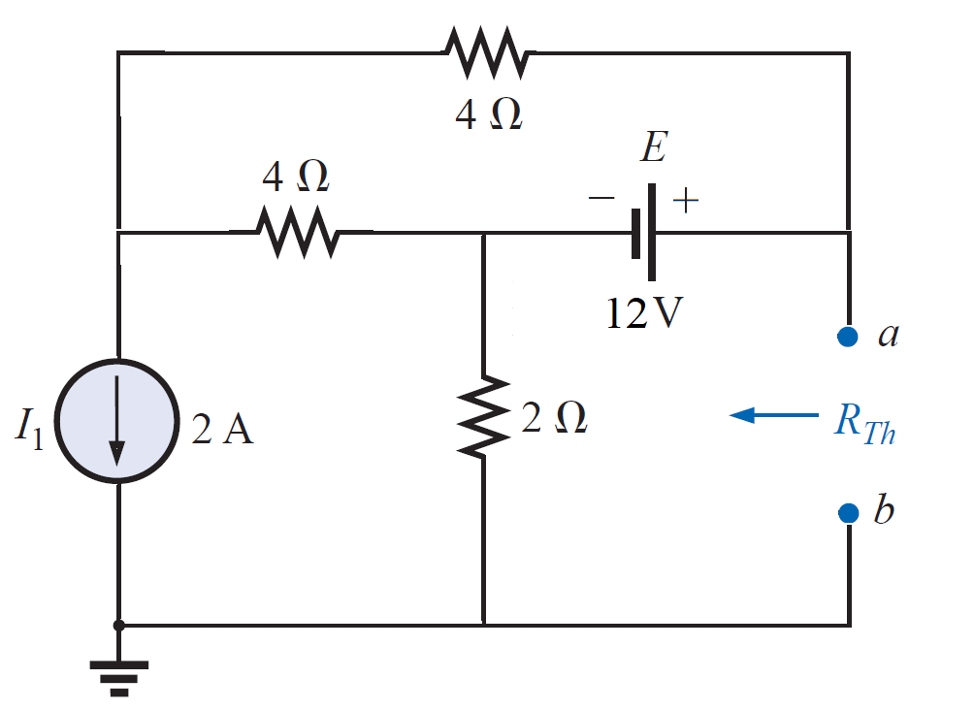
Thevenin's Theorem
EXAMPLE 2: Use the Thevenin theorem to find the current through 6 Ω for the circuit of figure shown.
Solution:-
Step 3:-

Slide 22
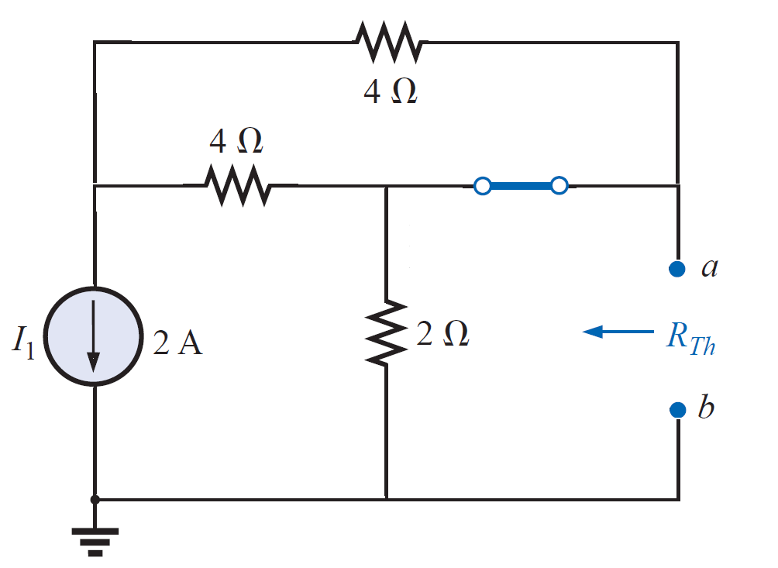
Thevenin's Theorem
EXAMPLE 2: Use the Thevenin theorem to find the current through 6 Ω for the circuit of figure shown.
Solution:-
Step 3:-

Slide 23
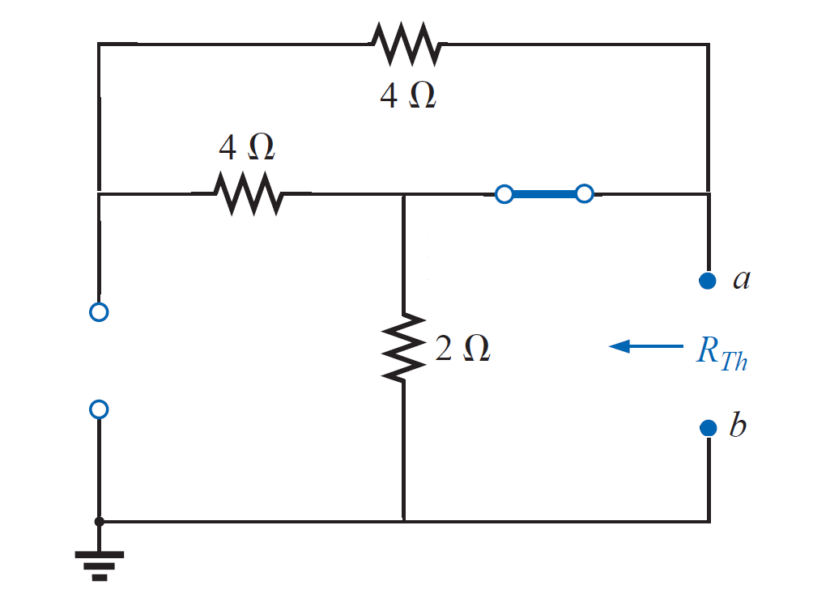
Thevenin's Theorem
EXAMPLE 2: Use the Thevenin theorem to find the current through 6 Ω for the circuit of figure shown.
Solution:-
Step 3:-

Slide 24
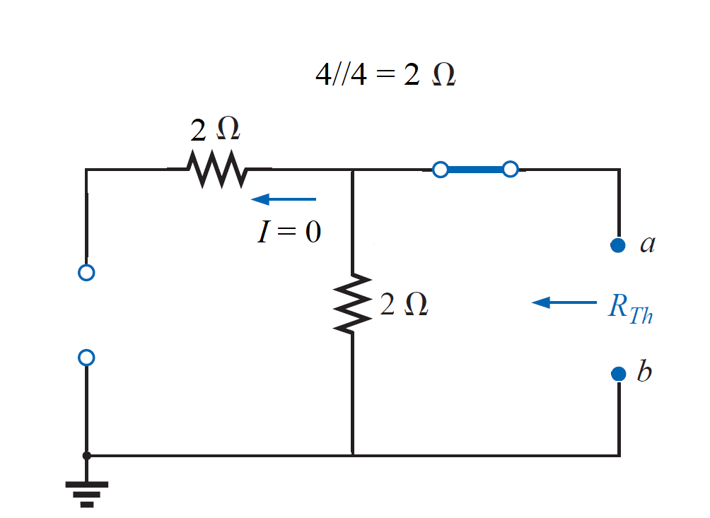
Thevenin's Theorem
EXAMPLE 2: Use the Thevenin theorem to find the current through 6 Ω for the circuit of figure shown.
Solution:-
Step 3:-

Slide 25
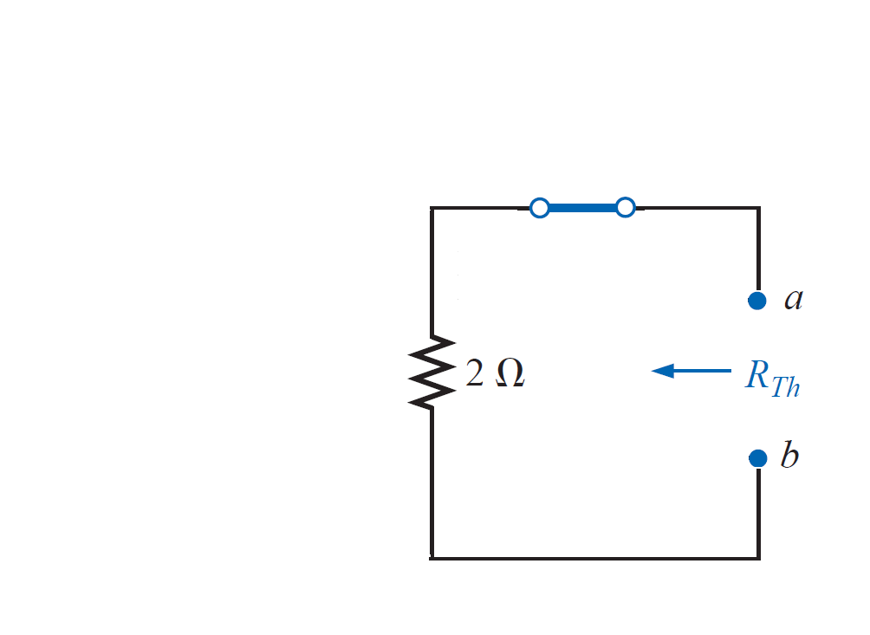
Thevenin's Theorem
EXAMPLE 2: Use the Thevenin theorem to find the current through 6 Ω for the circuit of figure shown.
Solution:-
Step 3:-
$$R_{Th}=2 Ω$$

Slide 26
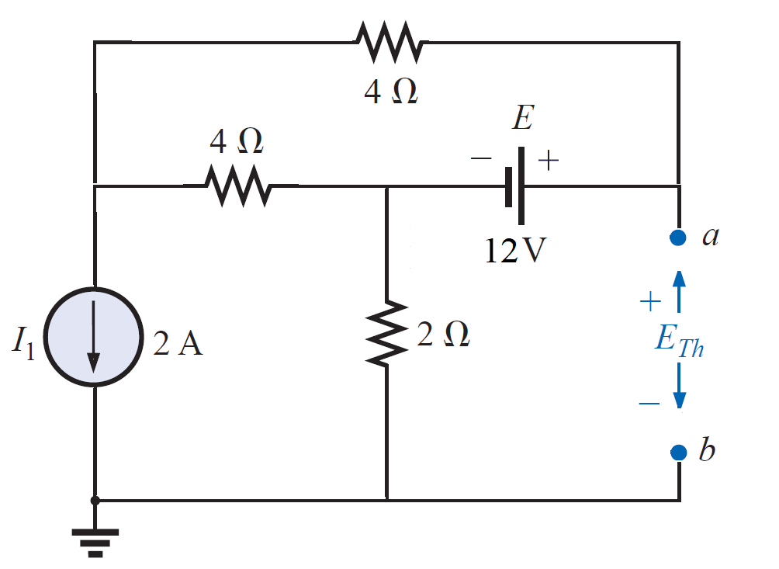
Thevenin's Theorem
EXAMPLE 2: Use the Thevenin theorem to find the current through 6 Ω for the circuit of figure shown.
Solution:-
Step 4:-

Slide 27
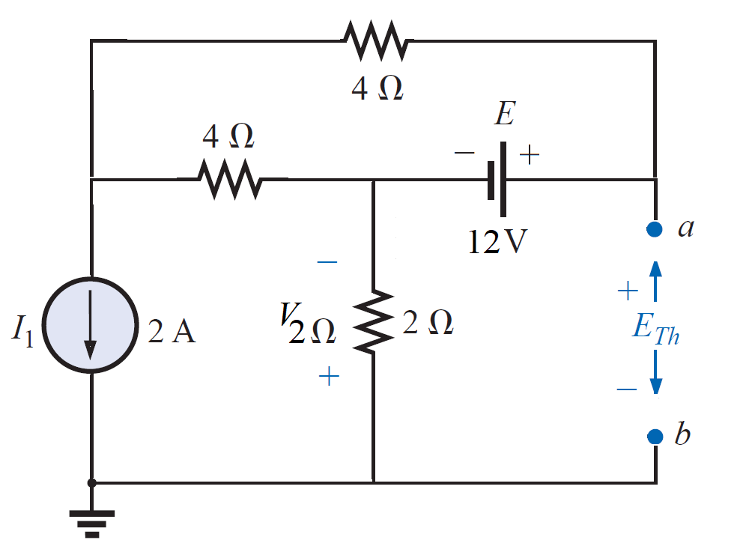
Thevenin's Theorem
EXAMPLE 2: Use the Thevenin theorem to find the current through 6 Ω for the circuit of figure shown.
Solution:-
Step 4:-
$$E_{Th}=E−V_{2Ω}$$

Slide 28
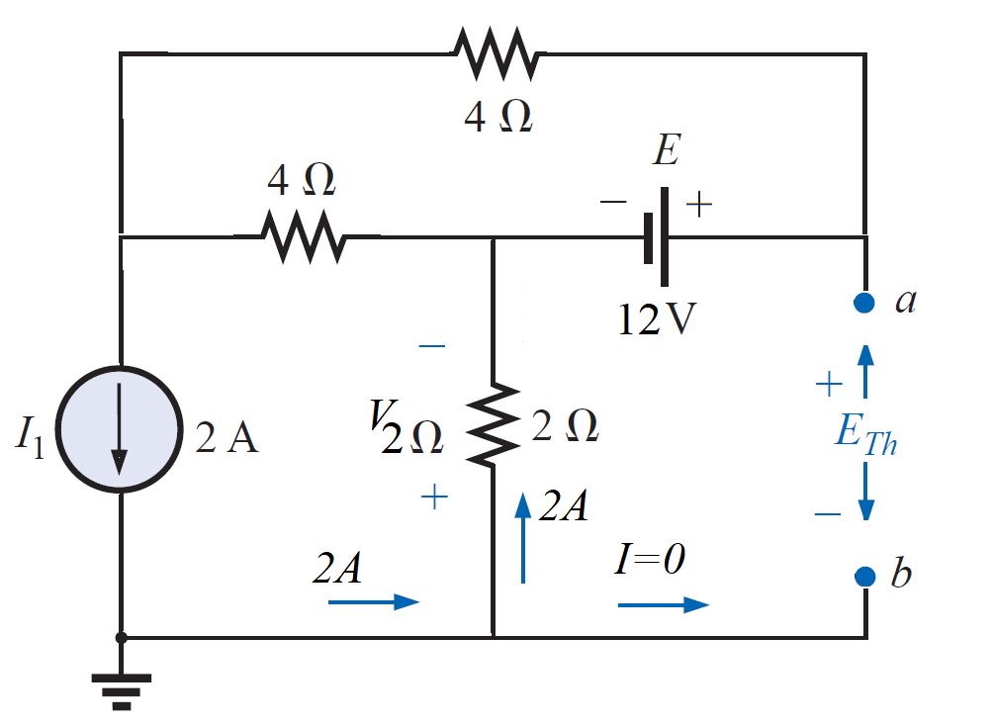
Thevenin's Theorem
EXAMPLE 2: Use the Thevenin theorem to find the current through 6 Ω for the circuit of figure shown.
Solution:-
Step 4:-
$$E_{Th}=E−V_{2Ω}$$
$$V_{2Ω}=2A×2Ω=4V$$

Slide 29
Thevenin's Theorem
EXAMPLE 2: Use the Thevenin theorem to find the current through 6 Ω for the circuit of figure shown.
Solution:-
Step 4:-
$$E_{Th}=E−V_{2Ω}$$
$$V_{2Ω}=2A×2Ω=4V$$
$$E_{Th}=12−4=8V$$

Slide 30
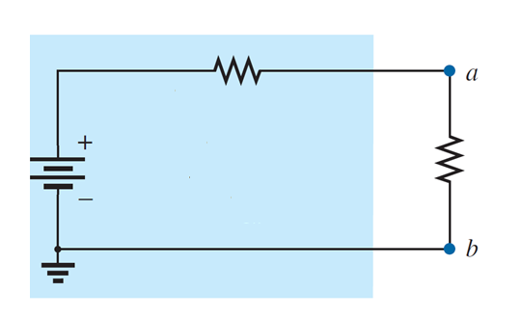
Thevenin's Theorem
EXAMPLE 2: Use the Thevenin theorem to find the current through 6 Ω for the circuit of figure shown.
Solution:-
Step 5:-
$$I_{L}=\frac{E_{Th}}{R_{Th}+R_{L}}$$
$$R_{Th}=2Ω$$
$$R_{L}=6Ω$$
$$E_{Th}=8V$$
$$I_{L}=\frac{8 V}{2Ω+6Ω}= \frac{8}{8}=1 A$$

Slide 31
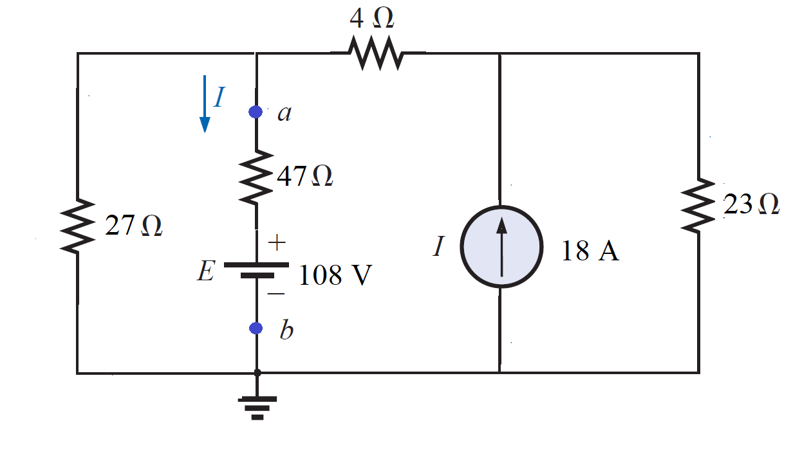
Thevenin's Theorem
EXAMPLE 3: Use the Thevenin’s theorem to find the current through the branch a-b for the circuit shown.

Slide 32
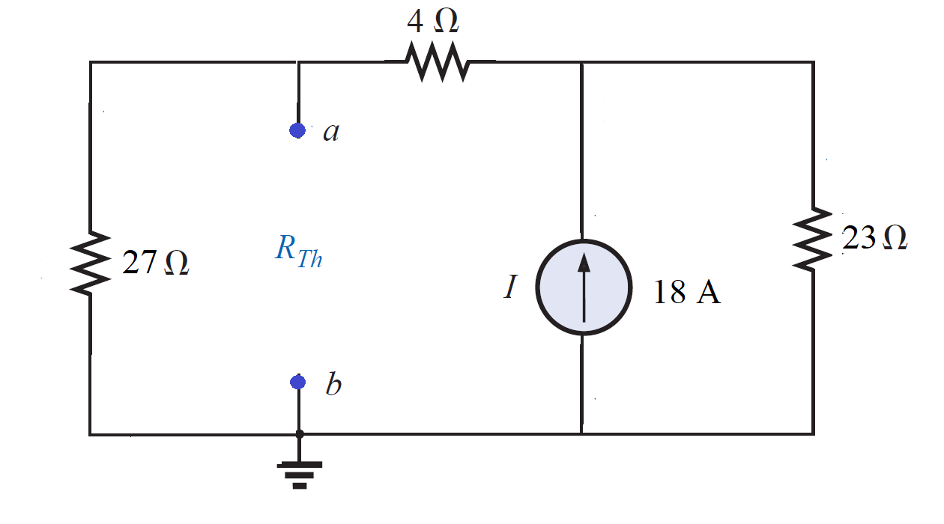
Thevenin's Theorem
EXAMPLE 3: Use the Thevenin’s theorem to find the current through the branch a-b for the circuit shown.
Solution:-
$$R_{Th}$$

Slide 33
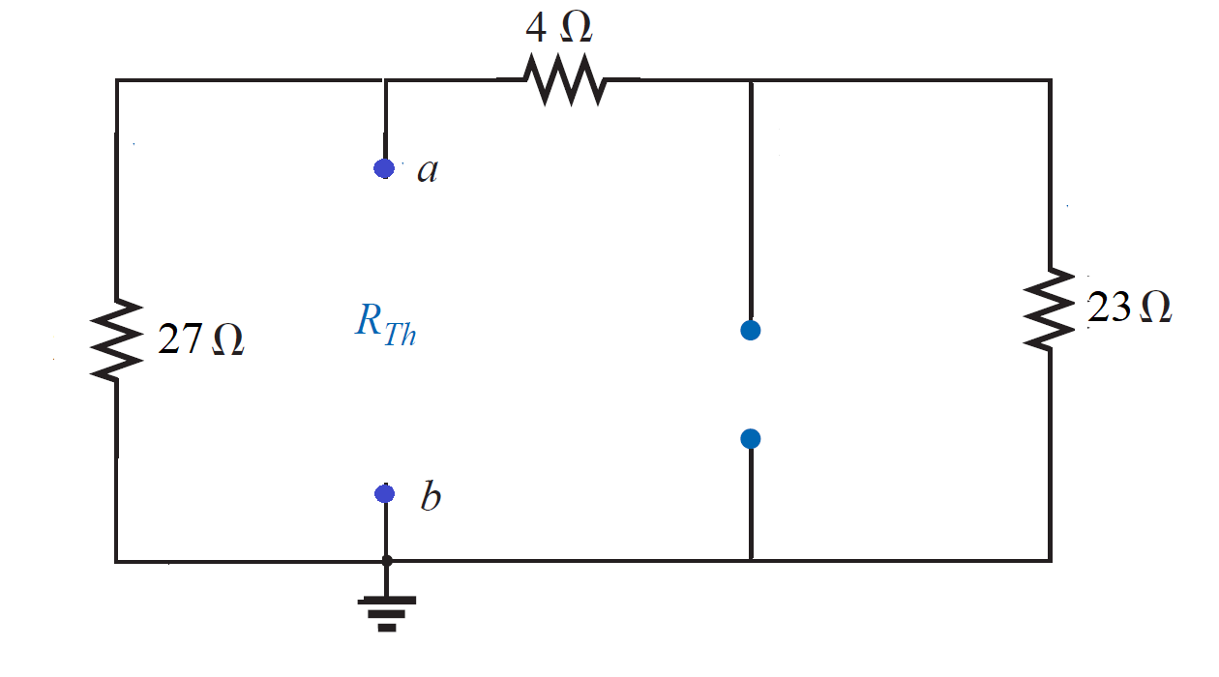
Thevenin's Theorem
EXAMPLE 3: Use the Thevenin’s theorem to find the current through the branch a-b for the circuit shown.
Solution:-
$$R_{Th}$$

Slide 34
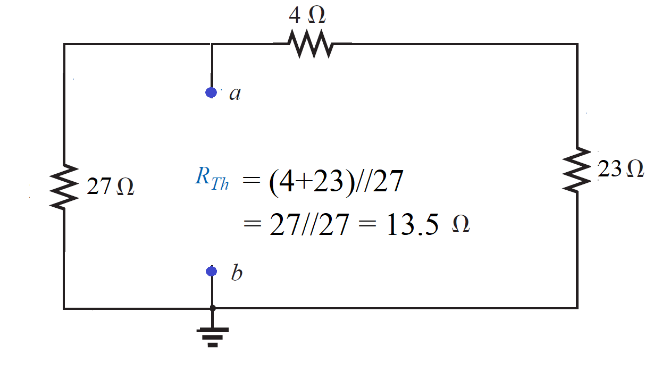
Thevenin's Theorem
EXAMPLE 3: Use the Thevenin’s theorem to find the current through the branch a-b for the circuit shown.
Solution:-
$$R_{Th}$$
$R_{Th}=(4Ω+23Ω)/$/ 27$Ω$ )
$=27Ω/$/ 27$Ω=13.5Ω$

Slide 35
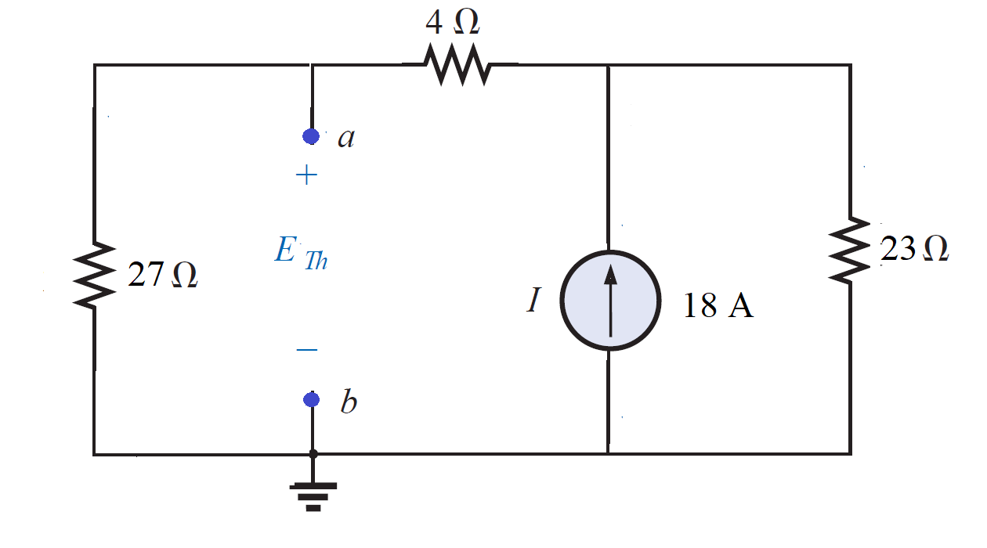
Thevenin's Theorem
EXAMPLE 3: Use the Thevenin’s theorem to find the current through the branch a-b for the circuit shown.
Solution:-
$$E_{Th}$$

Slide 36
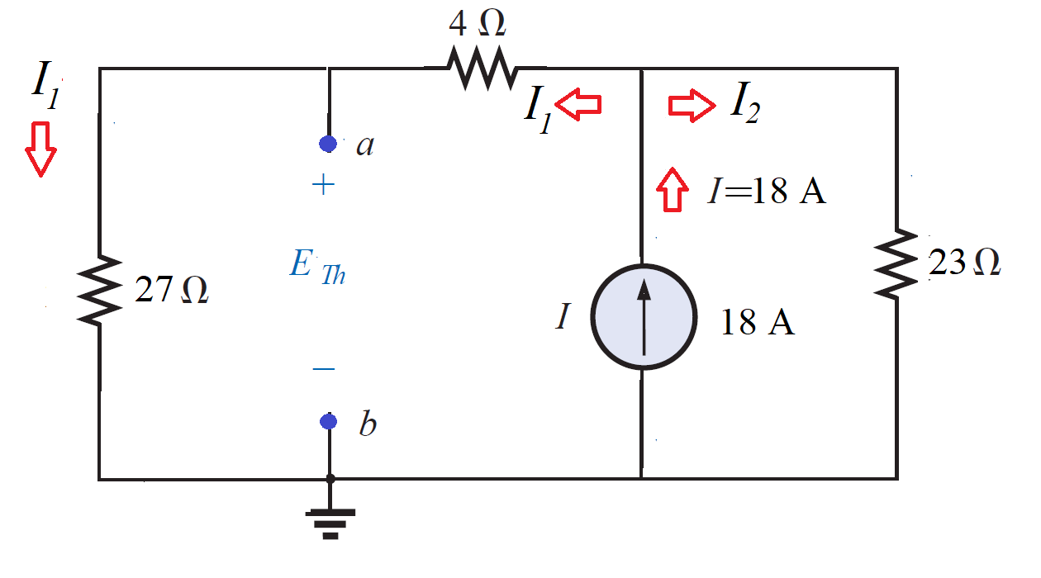
Thevenin's Theorem
EXAMPLE 3: Use the Thevenin’s theorem to find the current through the branch a-b for the circuit shown.
Solution:-
$$E_{Th}$$
$$E_{Th}=V_{27Ω}= I_{1}×27Ω$$
Applying the current divider rule to find I₁,
$$I_{1}= \frac{I (23Ω)}{23Ω+\left(27Ω+4Ω\right)}=\frac{(18A)(23Ω)}{54Ω}=7.67 A$$
$$V_{27Ω}= I_{1}×27Ω=7.67 A ×27Ω=207 V$$
$$E_{Th}=V_{27Ω}=207 V$$

Slide 37
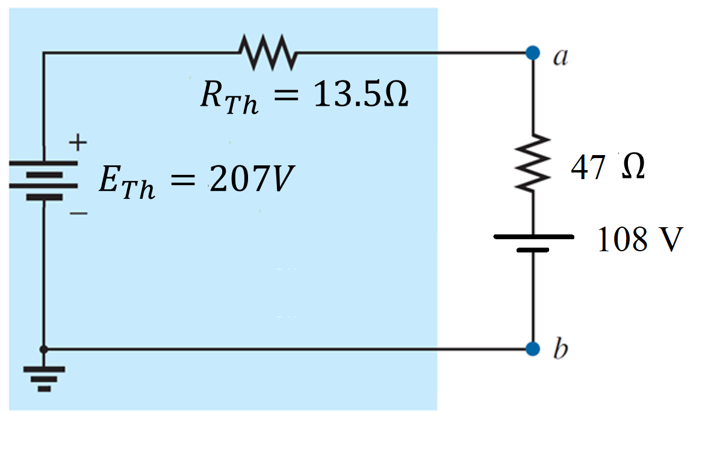
Thevenin's Theorem
EXAMPLE 3: Use the Thevenin’s theorem to find the current through the branch a-b for the circuit shown.
Solution:-
$$I_{L}=\frac{E_{Th}−108}{R_{Th}+R_{L}}$$
$$I_{L}=\frac{207 V−108V}{13.5Ω+47Ω}= \frac{99}{60.5}=1.64 A$$

Slide 38
References
Boylestad, Robert L. Introductory circuit analysis. Pearson Education, 2010.
Robbins, Allan H., and Wilhelm C. Miller. Circuit analysis: Theory and practice. Cengage Learning, 2012.
Sadiku, Matthew NO, and Chales K. Alexander. Fundamentals of electric circuits. McGraw-Hill Higher Education, 2007.

